Slide 1
Database Connectivity

Slide 2
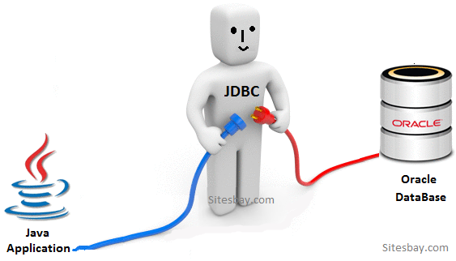
Java Database Connectivity
JDBC stands for Java Database Connectivity.
JDBC is a Java API to connect and execute the query with the database.
The JDBC API defines interfaces and classes for writing databases applications in Java by making database connection.
Notes:
Classes in this API are used to communicate with database

Slide 3
Java classes connection with DB
To insert data into a MySQL database from a Java application using Eclipse, you'll need to follow these steps:
Set up your MySQL database and create a table where you want to insert data.
Download and add the MySQL JDBC driver to your Eclipse project. You can download it from the official MySQL website or use a Maven dependency.
Create a Java class for your application.
Write the Java code to insert data into the MySQL database.

Slide 4
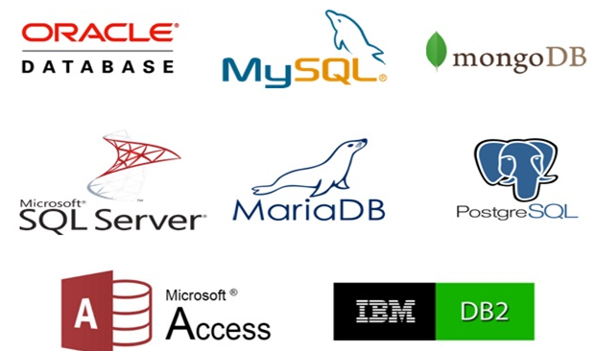
Database
Database is a set of files containing application data.
This data needs to be inserted, deleted, updated, extracted for any valid reason.
  You can write programs to perform all such actions
  You can use readymade database management software like Oracle and MySQL.
A Database Management Software or DBMS is used for storing, manipulating, and managing data in a database environment. Users can construct their own databases using a DBMS to satisfy their business requirements.
Notes:
60 million queries per second, and nearly 4 million row changes per second”

Slide 5
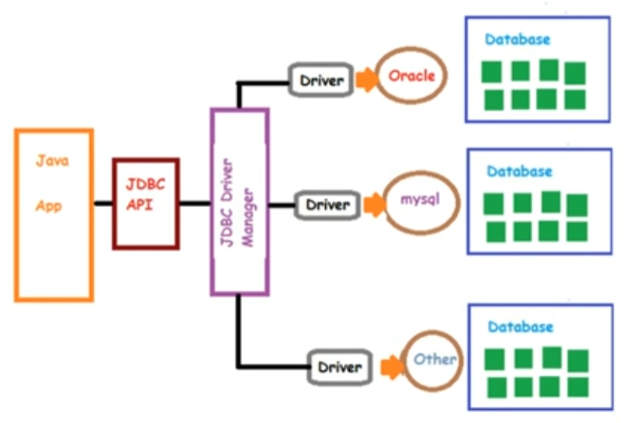
JDBC Architecture

Slide 6
Why Should We Use JDBC
Before JDBC, ODBC API was the database API to connect and execute the query with the database. But, ODBC API uses ODBC driver which is written in C language (i.e. platform dependent and unsecured). That is why Java has defined its own API (JDBC API) that uses JDBC drivers (written in Java language).
We can use JDBC API to handle database using Java program and can perform the following activities:
  Connect to the database
  Execute queries and update statements to the database
  Retrieve the result received from the database.

Slide 7
Basic steps to use a database in Java
Establish a connection
Create JDBC Statements
Execute SQL Statements
GET ResultSet
Close connections

Slide 8
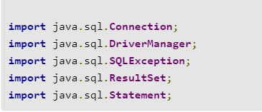
JDBC imports
Connection represents the connection to the database.
DriverManager obtains the connection to the database.
SQLException handles SQL errors between the Java application and the database.
ResultSet and Statement model the data result sets and SQL statements.

Slide 9
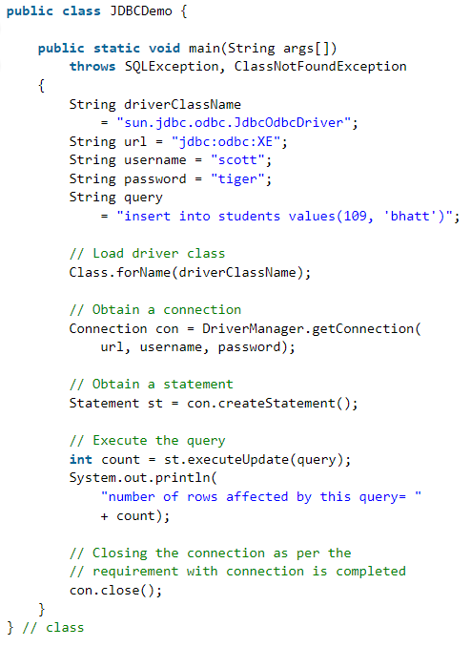
Handing SQL Exception
Setting DB Credentials
CRUD Query
Load driver
Establish Connection
Execute queries with the database

Slide 10
DriverManager class
The DriverManager class acts as an interface between user and drivers. It keeps track of the drivers that are available and handles establishing a connection between a database and the appropriate driver.
The DriverManager class maintains a list of Driver classes that have registered themselves by calling the method DriverManager.registerDriver().

Slide 11
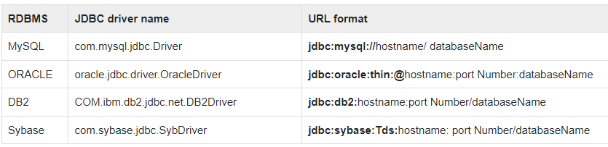
Connection interface
Connection interface resides in java.sql package and it represents a session with a specific database you are connecting to.

Slide 12
Statement interface
The Statement interface provides methods to execute queries with the database.
The important methods of Statement interface are as follows:
  public ResultSet executeQuery(String sql): is used to execute SELECT query. It returns the object of ResultSet.
  public int executeUpdate(String sql): is used to execute specified query, it may be create, drop, insert, update, delete etc.
  public boolean execute(String sql): is used to execute queries that may return multiple results.
  public int[] executeBatch(): is used to execute batch of commands.

Slide 13
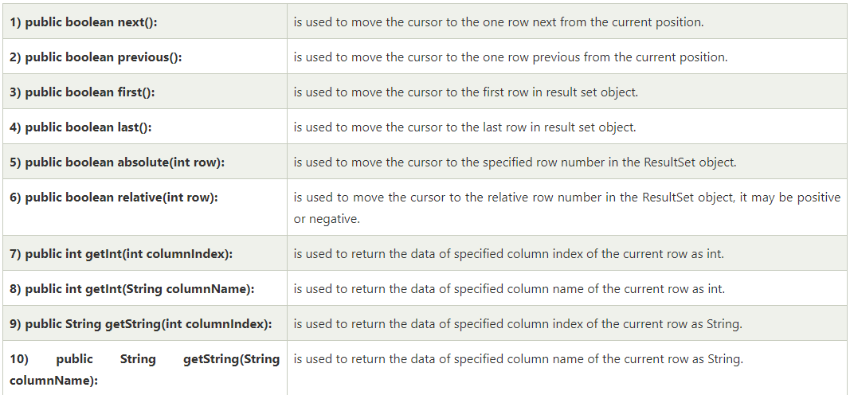
ResultSet interface
The object of ResultSet maintains a cursor pointing to a row of a table. Initially, cursor points to before the first row.

Slide 14
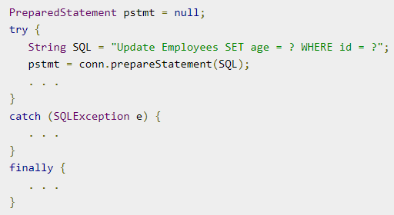
PreparedStatement interface
The PreparedStatement interface is a subinterface of Statement. It is used to execute parameterized query.

Slide 15
Oracle Java Connectivity Demo

Slide 16
Requirements
Eclipse
JDK
Oracle Setup
Oracle JDBC Driver

Slide 17
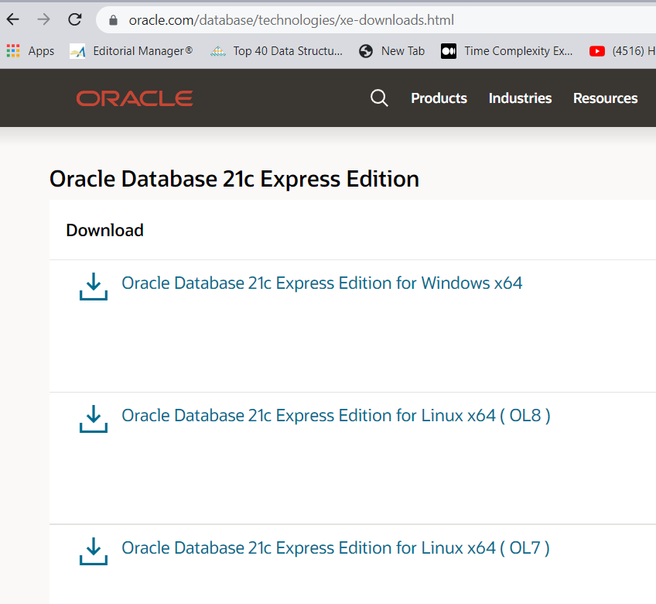
Install Oracle
Install https://www.oracle.com/database/technologies/xe-downloads.html

Slide 18
Prerequisites
Oracle JDBC Driver
  https://www.oracle.com/database/technologies/appdev/jdbc-downloads.html

Slide 19
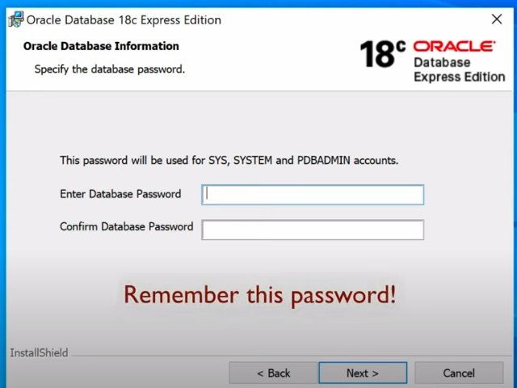
Important to remember password

Slide 20

Connect to database
Open SQL Plus
connect sys/[password set during oracle installation]@localhost:1521/XE as sysdba;

Slide 21
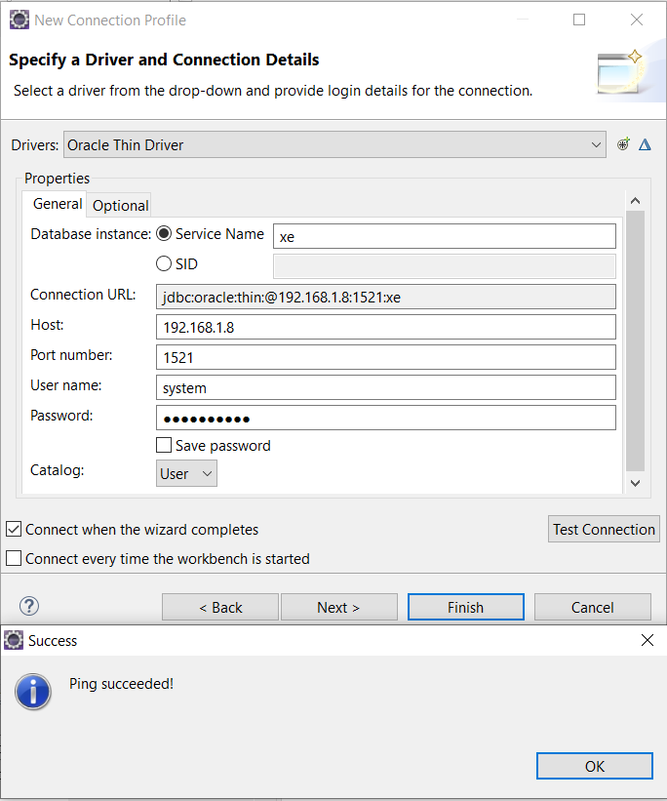
Open Eclipse-> open perspective -> Database Development -> New Connection Profile -> Oracle -> New Driver Definition -> Oracle Thin Driver -> Jar List -> provide OJDBC.jar
Notes:
https://www.youtube.com/watch?v=vxRXDK2Szfg
Oracle Listener how to handle error message ORA 12541 TNS no listener
lsnrctl status
lsnrctl start
lsnrctl services

Slide 22
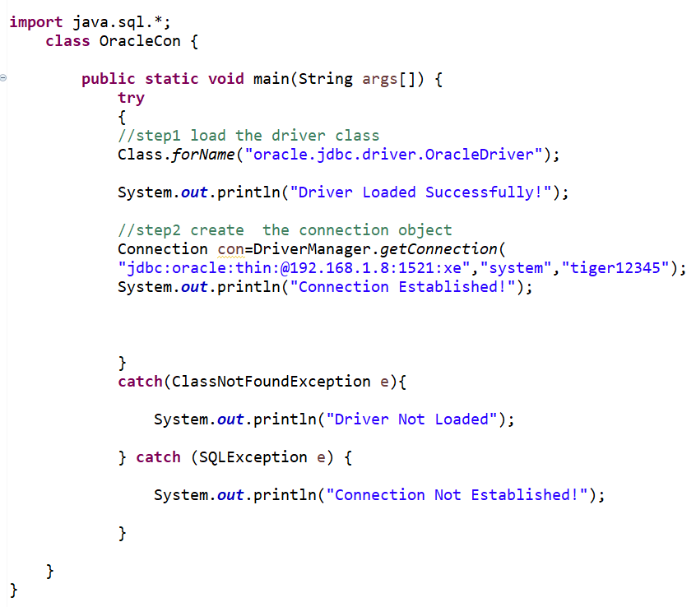
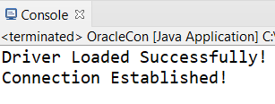
Connecting to the database
The driver class for the oracle database is oracle.jdbc.driver.OracleDriver.
where jdbc is the API, oracle is the database, thin is the driver, IP address, 1521 is the port number and XE is the Oracle service name.
The default username for the oracle database is system.
password given by the user at the time of installing the oracle database.

Slide 23
CRUD Operations

Slide 24
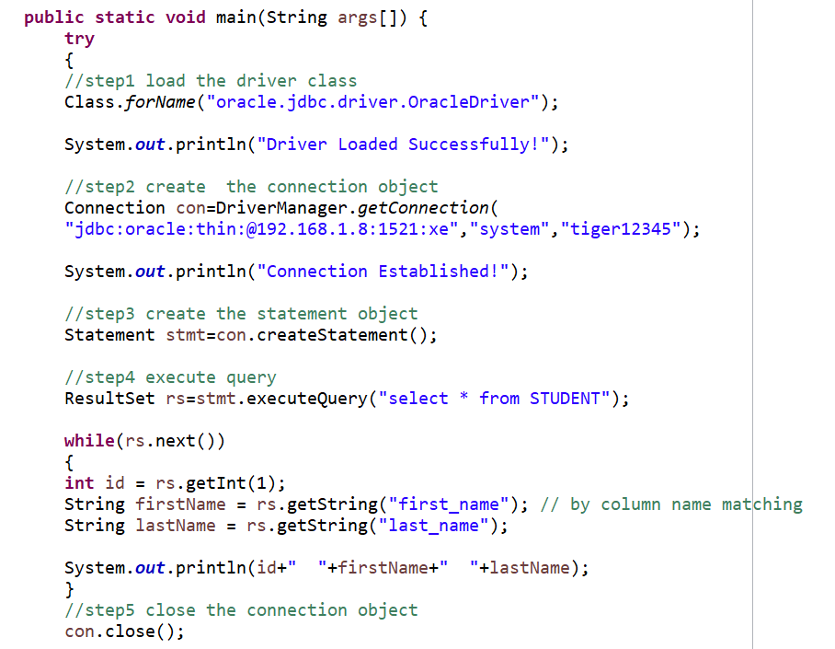
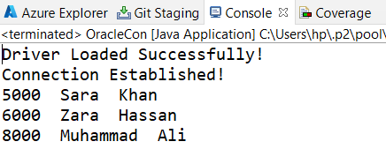
Retrieve Data from Database

Slide 25
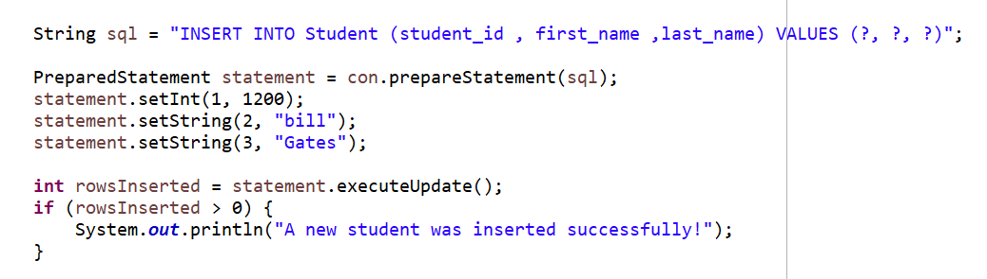
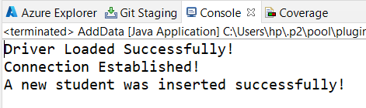
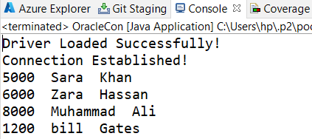
INSERT Statement

Slide 26
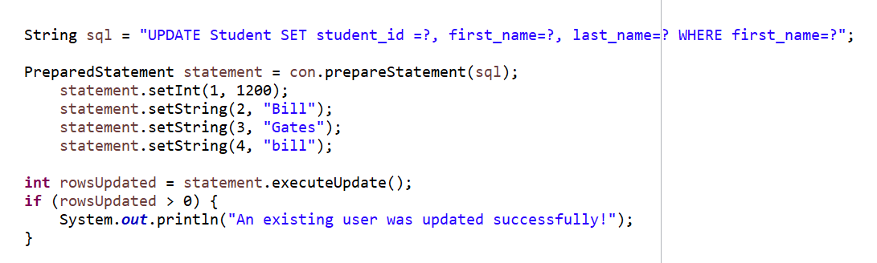
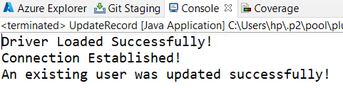
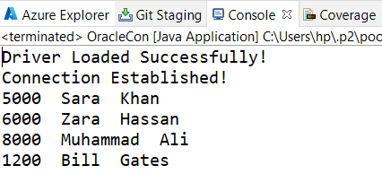
UPDATE Statement

Slide 27
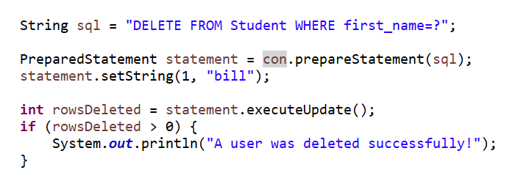
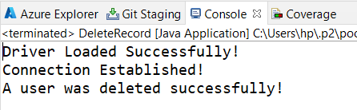
DELETE Statement

Slide 28
MySQL Database
Connect to MySQL database in Eclipse IDE using Database Development perspective:
  Download MySQL https://dev.mysql.com/downloads/installer/
  Download MySQL JDBC driver https://dev.mysql.com/downloads/connector/j/
  Create Database and Table in MySQL
  Execute SQL Statements

Slide 29
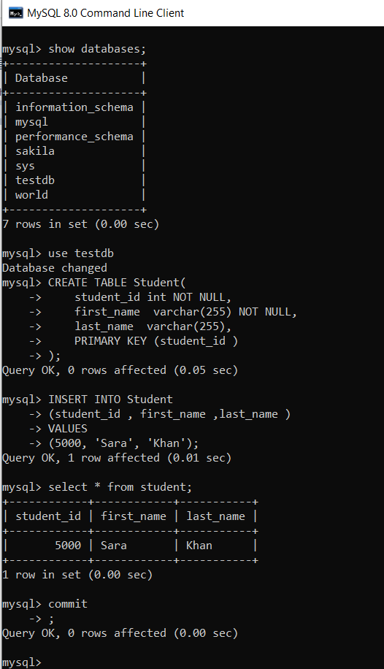
MySQL Command Line Activities
Notes:
CREATE DATABASE testDB;

Slide 30
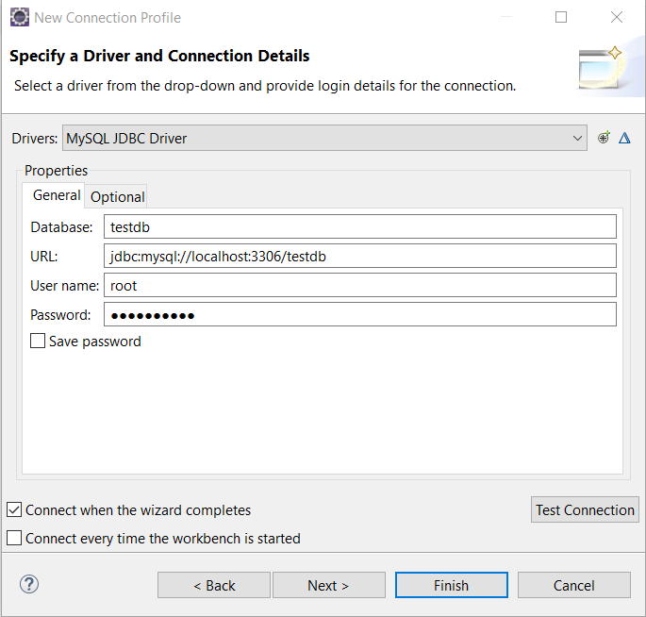
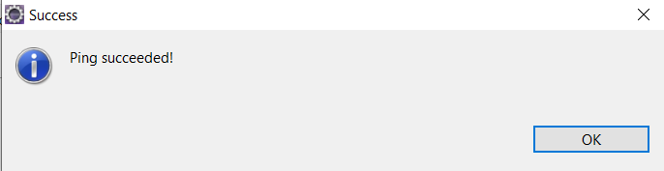
Database Development perspective in Eclipse

Slide 31
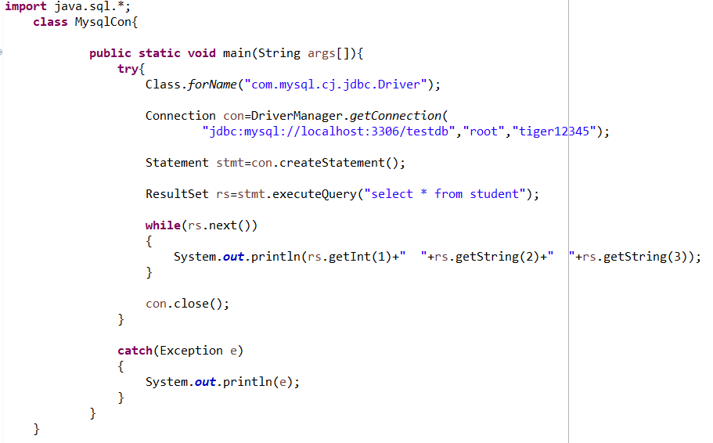

Connect Java Application with mysql database

Slide 32
Design for Change
Identify the functionality that may change (frequently?)
Take special consideration in implementing such functionality in classes, so that the changing functionality will have minimized impact on the other parts
Use the principles of Polymorphism to provide a stable interface of the potentially varying functionality.
Notes:
Indirection introduces an intermediate unit to communicate between the other units, so that the other units are not directly coupled.
How to avoid impact of variations of some elements on the other elements. It provides a well defined interface so that the there will be no affect on other units.

Slide 33
Design for Change – Write to Interfaces
The client classes are to be written in a way that they talk to the stable interface
Example – Handling Persistence
  Probability of change?

Slide 34
Example – Handling Persistence
Student
Option 1
Write SQL Queries here
Problem?
save()
Notes:
Business logic and DB service layers are merging
increase coupling
Cohesion reduced
create connection
Mention sql queries
Impact of change is global
A good OO design can be managed through by adding new classes

Slide 35
Example – Handling Persistence
Option 2
Write SQL Queries here
Benefits over Option 1
Problem?
Student
DBHandler
save()
saveStudent(this)

Slide 36
Example – Write to Interfaces
Option 3
Write to interfaces
Benefits over other options
Problem? When to initialize and how?
Student
PersistenceHandler
save()
saveStudent(this)
Student
PersistenceHandler
OracleDBHandler
SQLPersistence

Slide 37
Implementation
//Student
  Class Student{
  PersitenceHandler persHandler;
  void save(){
  persHandler.saveStudent(this);
  }
  void setPersitenceHandler (PersitenceHandler ph)
  {
  this.persHandler=ph;
  }

Slide 38
Implementation
// PersistenceHandler
Class PersistenceHandler{
abstract void saveStudent(Student s);
}

Slide 39
Implementation
class OracleDBHandler extends PersistenceHandler{
  void saveStudent(Student s){
    //connection
    //insert query formulation
    //execute query
  }
  }

Slide 40
Implementation
class SQLHandler extends PersistenceHandler{
  void saveStudent(Student s){
  //connection
  //insert query formulation
  //execute query
  }
  }

Slide 41
Implementation
Main
  Void main()
  {
    PersitenceHandler handler= new OracleHandler();
    University uni= new University();
    Uni. setPersitenceHandler(handler);
  }

